Slide 1
Conceptual Design Review
CubeSat | Control
MECH 4000 – Product Design I
4 Sept 2024
Ben Sherman
Trace Shafer

Slide 2
Overview
Design Statement
Deliverables
Needs Analysis
Specification Development
Specifications
Benchmarking
Market Analysis
Concept Generation
Decision Matrix
Concept Selection

Slide 3



Design Statement
Stakeholders: Utah NASA Space Grant Consortium, Utah Division of Water Resources
Sponsors: RAM, PTC, Washington County Water Conservancy District
Design Statement: Design, prototype, and evaluate attitude control system to point at a set location on Earth while taking a photo from low Earth orbit.
Notes:
Notes:
State who your sponsor is and give a short background.
Read the design statement verbatim
Give the 1000-foot view of the project.
List your talking points with details. You will not read from these notes and these notes may contain information that you forget to mention in your presentation.
Everything needs to be in bullet point form and put in presenting order.

Slide 4
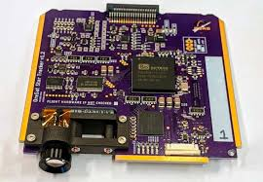
Deliverables
Designed, manufactured, and tested hardware to control the CubeSat while in space.
Developed software for sensor data processing, control algorithms, and actuator command generation.
Working star tracker hardware and software.
Notes:
Talking Points:
State your deliverables.
Elaborate on deliverables as needed.

Slide 5
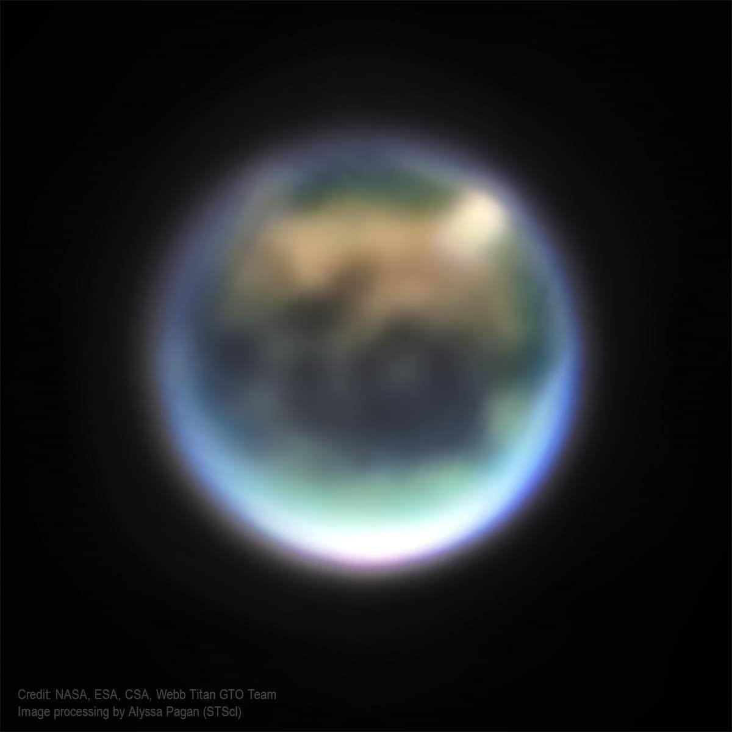
Needs Analysis
Without a way to control the CubeSat, we will not be able to point at Utah while in space and provide accurate data to the Utah Division of Water Resources and the Washington County Water Conservancy District.
If we want to be able to point the camera at Utah, how are we going to do that? We need to be able to control it so we can get data, sending a satellite into space without being able to control it would not be helpful.
Notes:
Notes:
Talking Points:
Internal needs --- needs from the perspective of your sponsor
External needs --- needs from multiple perspectives outside of your sponsor
Why is this product needed?

Slide 6
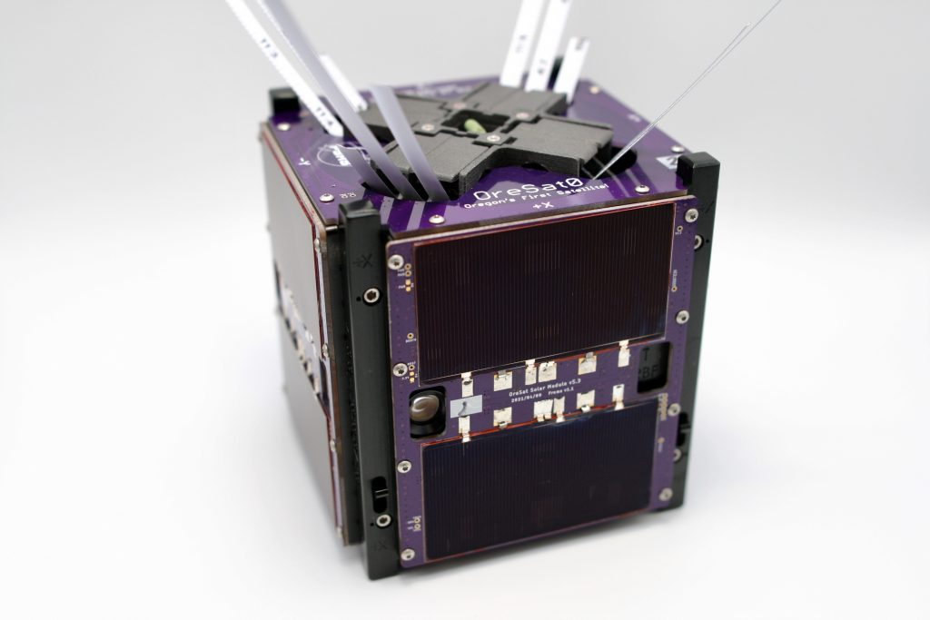
Specification Development
Statement of Work---CubeSat 101---System Integration and Project Manager
Objectives
Precise Attitude Control: Achieving precise orientation for the CubeSat’s payload.
Reliable Performance: Ensuring reliable attitude adjustments and maintaining stability.
Efficient Resource Usage: Utilizing power and computational resources efficiently.
Robust System: Developing a robust control system capable of handling unexpected disturbances.
Notes:
Notes:
Discuss the Objectives of your design
Discuss the Functions of your design
Discuss the Constraints placed on your project

Slide 7
Specification Development
Statement of Work---CubeSat 101---System Integration and Project Manager
Functions
Measure Attitude: Sensors measure the CubeSat's orientation relative to reference points.
Adjust Orientation: Control algorithms adjust the CubeSat’s orientation to the desired position.
Calibrate Sensors: Proper calibration ensures accurate sensor readings for precise attitude determination.
Monitor Performance: Continuous monitoring helps maintain optimal attitude control and detect any anomalies.
Validate Algorithms: Testing and validation ensure that attitude control algorithms perform as expected in space conditions.
Notes:
Notes:
Discuss the Objectives of your design
Discuss the Functions of your design
Discuss the Constraints placed on your project

Slide 8
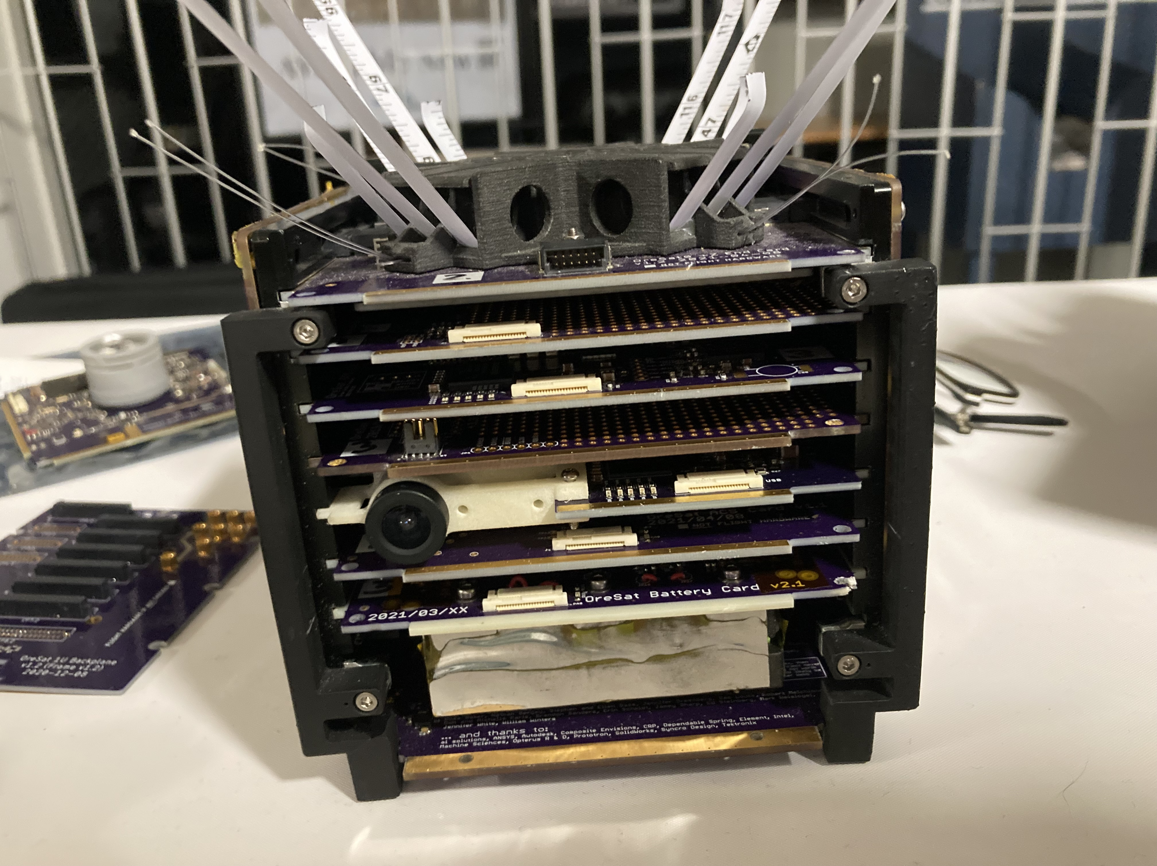
Specification Development
Statement of Work---CubeSat 101---System Integration and Project Manager
Constraints
Power
Accuracy
Size
Weight
Budget
Notes:
Notes:
Discuss the Objectives of your design
Discuss the Functions of your design
Discuss the Constraints placed on your project

Slide 9
Specifications
Table of Metrics
Status | Metric | Description | Units | Acceptable Values
F | Rotating Accuracy | How precise the reaction wheels need to be to keep pointed at Utah | Degrees | x<1
F | Power Consumption | How much power we are going to be using to control the CubeSat | Watts | x<6
F | Operational Temperature Range | How wide of a Temperature range the CubeSat controls can operate at | Celsius | -40>x< 85
F | Cost | How much the control section costs to produce | Dollars | x<1500
Notes:
Notes:
Describe each metric and how they were derived from your objectives, functions, and constraints

Slide 10
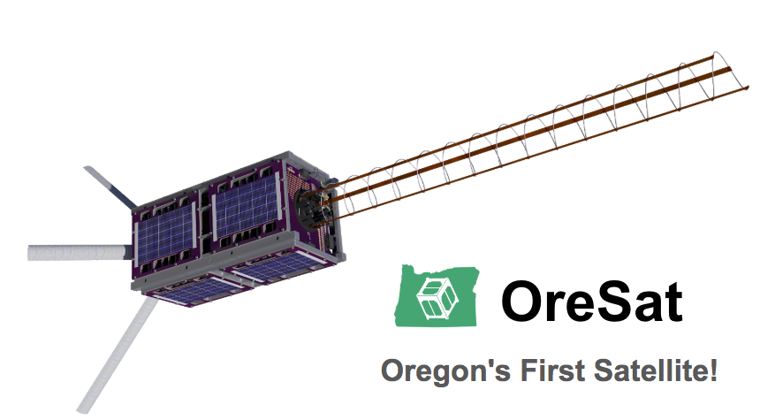
Benchmarking
After looking at the OreSat satellite, they used four reaction wheels to control the CubeSat. One for each direction in the X and Y axis. Three magnetorquers are being used for the X, Y, and Z directions.
Some deficiencies that have been seen is not using attitude control for their satellite. Attitude control is important for our CubeSat because it is important for orbit control and orienting the CubeSat.
Notes:
Notes:
Talking Points:
What has already been done to solve the problem that your product will solve
What are the strengths of existing solutions?
What are the deficiencies of existing solutions?
Talk about existing solutions from a quantitative perspective. How well do the existing solutions meet your target metrics? Make a case for why existing solutions will not work in the case of your project.

Slide 11


Market Analysis
Utah Department of Water Resources
Washington County Water Conservancy District.
Mainly this is for Utah, but other states such as Arizona and Idaho want in as well.
Notes:
Notes:
Who are your target customers (be specific)
Describe the use case for your target customers
Give an estimate of the size of your market and their geographical location

Slide 12
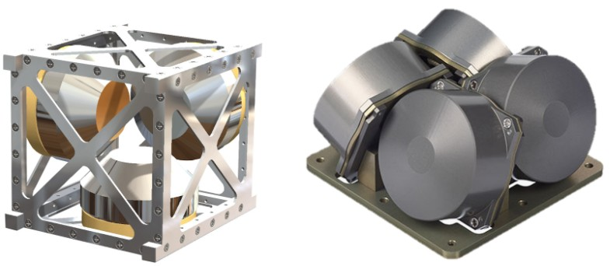
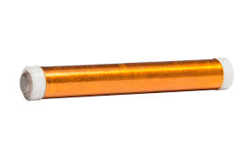
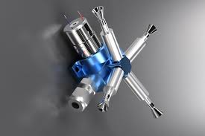
Concept Generation
Idea 1: Reaction Wheels
Idea 2: Magnetorquers
Idea 3: Gas Rocket(Liquid Hydrogen/Oxygen)
Notes:
Notes:
Introduce concepts that the team generated. Each finalist conceptual design is required to be developed over a minimum of one week post conception before judging with a decision matrix.
Describe the techniques that your team used to derive the finalist conceptual designs (you must provide evidence of using at least 3 different techniques – these will be discussed in class)

Slide 13
Decision Matrix
Concept 1: Reaction Wheels
Concept 2: Magnetorquers
Concept 3: Gas Rocket
Metric | Weight | Rank(1) | Total(1) | Rank(2) | Total(2) | Rank(3) | Total(3)
Rotating Accuracy | 60 | 3 | 180 | 1 | 60 | 2 | 120
Power Consumption | 10 | 1 | 10 | 2 | 20 | 3 | 30
Operational Temperature Range | 10 | 1 | 10 | 2 | 20 | 3 | 30
Cost | 20 | 2 | 40 | 3 | 60 | 1 | 20
TOTAL | 100 |  | 240 |  | 140 |  | 200
Notes:
Notes:
Walk through the evaluation process for each finalist conceptual design.
Articulate team thoughts concerning each finalist conceptual design.

Slide 14
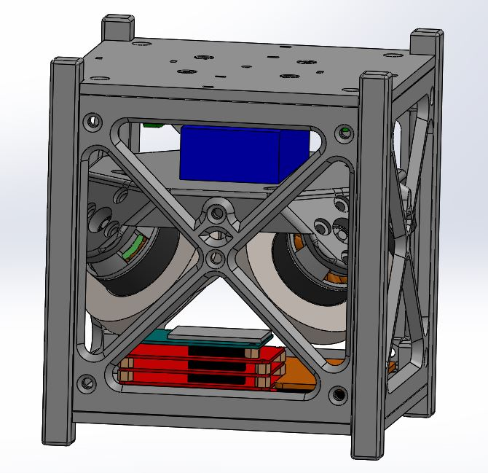
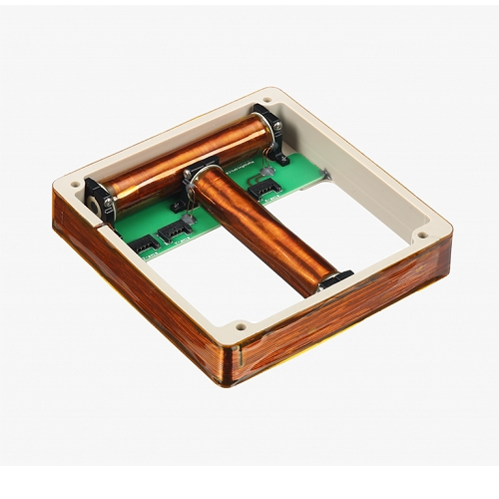
Concept Selection
We have decided to go with a mix of Idea 1 and Idea 2.
4 reaction wheels to point payload at Utah.
3 magnetorquers to stabilize the CubeSat.
Notes:
Notes:
Announce the conceptual design that your team chose
Recount your discussion with your sponsor. What are their thoughts? Are they onboard with this selected conceptual design?

Slide 15
Questions

